Slide 1

UML State Diagrams
Dr Rami Bahsoon
School of Computer Science
University of Birmingham, UK
r.bahsoon@bham.ac.uk

Slide 2
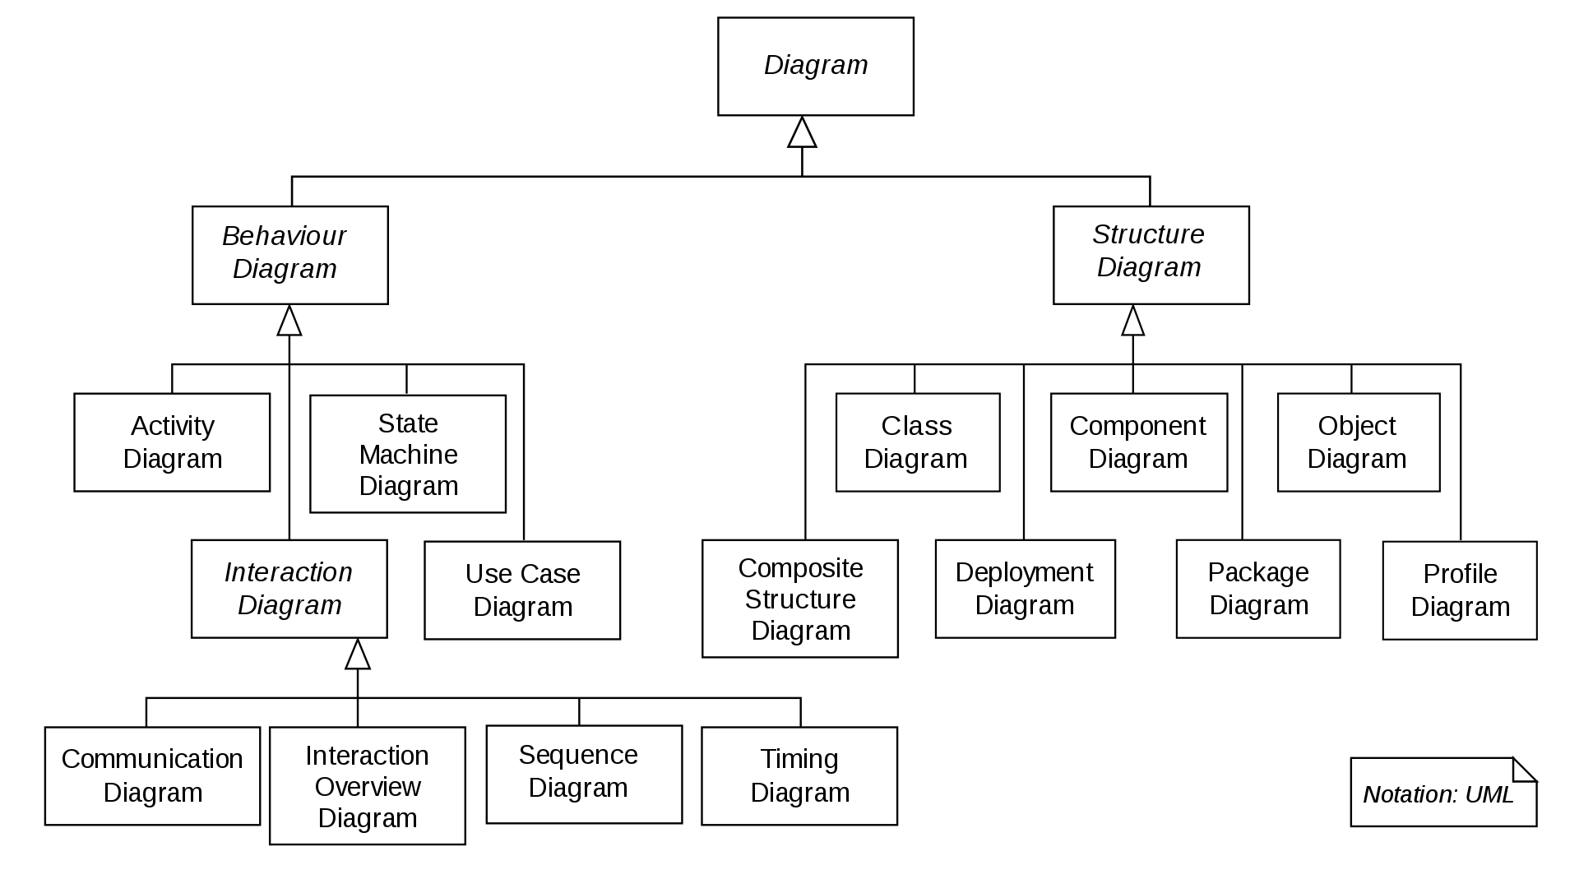
UML 2.X: This Lecture
UML 2.X
Collaboration Diagram

Slide 3


Note: use of State diagrams
Often used for modelling the behaviour of components (subsystems) of real time and critical systems….

Slide 4
State Diagrams
Also known as statecharts (invented by David Harel)
It shows the states which an object or a (sub)system – depending on the level of abstraction – can have at runtime
It also shows the events which trigger a change of state.
A class has at most one state machine diagram
Models how an object’s reaction to a message depends on its state
» Objects of the same class may therefore receive the same message, but respond differently

Slide 5
States and Events
The Book states could be
The related events could be
On shelf
Borrow
Copy of a
Book
On loan
return
maybe lost

Slide 6
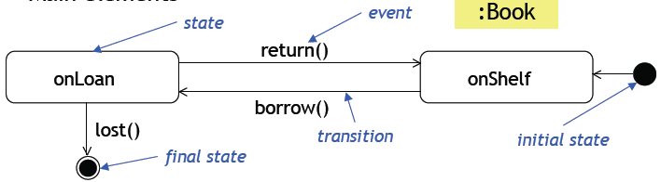
A Simple State Machine Diagram
Object: copy of book
Return()
borrow()
On loan
Copy of book
On shelf

Slide 7
Conditional Notions
Conditional notation is used if the value of an object’s
attributes determines the change of state( i.e., change the state under this condition….)
Self-transition
Note:
For some guards use keywords like
After followed by expression
When followed by expression
Or Conditions

Slide 8
Example: ATM Machine
States of ATM machine itself…
Idle
Serving customer
busy
Customer served
Out of order

Slide 9
Example: ATM Machine
States of ATM machine itself… is rather trivial….
Let us see how we can model the sub state busy
Idle
Serving customer
busy
Customer served
Out of order

Slide 10
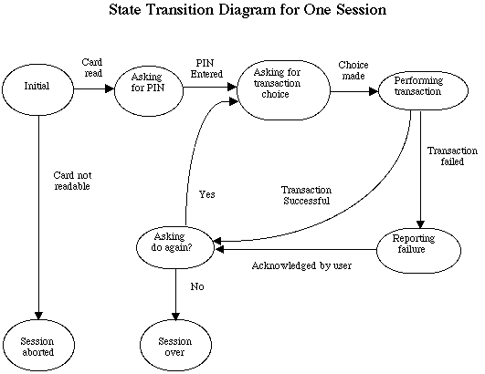
Example: ATM Machine
Use rounded rectangle!
Wrong pin
Correct
Reading card
After
Three wrong Trials
Retain card

Slide 11
Example: ATM Machine
Composite/nested State Machine diagrams
Busy
Wrong pin
Correct
Reading card
Serving customer
After
Three wrong Trials
Idle
Retain card
Customer served
Out of order

Slide 12
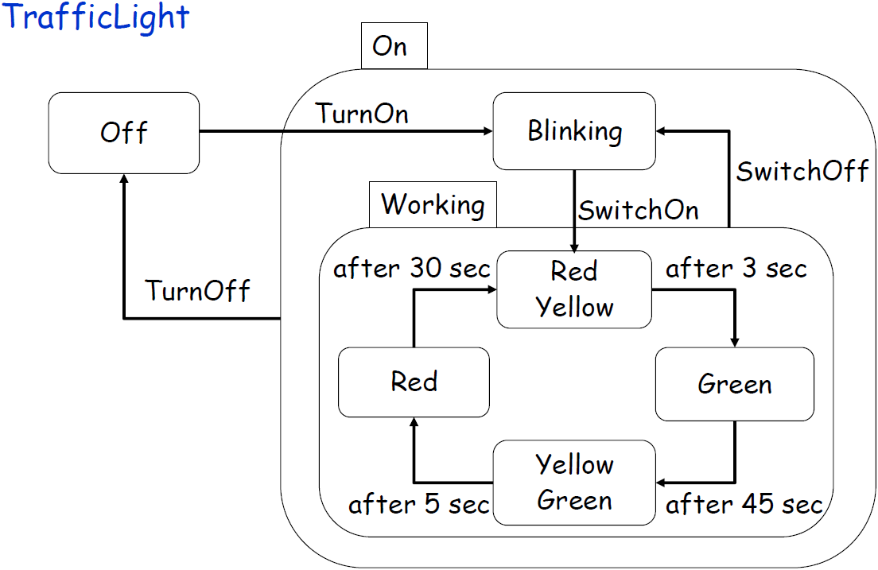
Composite/nested State Machine diagrams
Activities in states can be composite items that denote other state diagrams
Sub-states

Slide 13
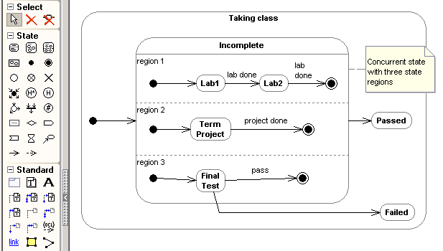
Concurrent States
Concurrent state: a state can be broken into several orthogonal state diagrams that run concurrently.

Slide 14
State Machine vs. Sequence Diagram
State machine diagrams help to identify
Changes to an individual object over time
Sequence diagrams help to identify
The temporal relationship between objects
Sequence of operations as a response to one or more events

